Slide 1
myTaxiService
Design Document

Slide 2
Outline
Problem
Architecture of the system
Components
Deployment
Runtime
Styles
Some algorithms

Slide 3
Problem
Let’s summarize:
Application that permits passengers to call taxi drivers
(Immediate) requests and reservations possible
Managing of taxi queues
Ordering policy

Slide 4
High level view

Slide 5
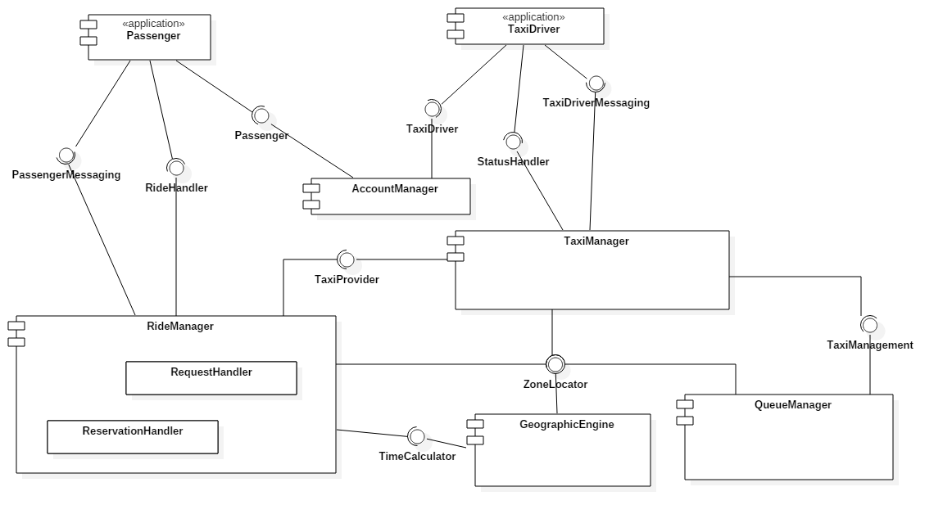
High level components

Slide 6
Component view

Slide 7
Account Manager
Passenger
Passenger login(username, password)
Given valid credentials, allows the passenger to receive a session and to login.
void logout(passenger)
Given a valid session, it deletes it.
boolean register(username, password)
It creates a new account for a passenger with the credentials provided.
boolean deleteAccount(username, password)
Given valid credentials, it deletes the account associated.

Slide 8
Account Manager
TaxiDriver
TaxiDriver login(username, password)
Given valid credentials, allows the taxi driver to receive a session and to login.
void logout(TaxiDriver taxiDriver)
Given a valid session, it deletes it.

Slide 9
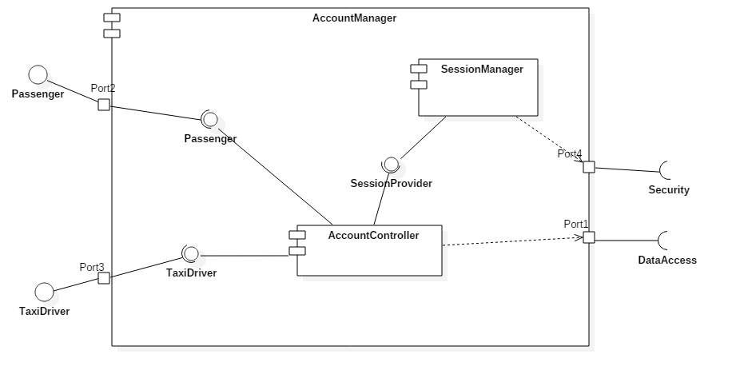

Slide 10
Ride Manager
RideHandler
Response makeRequest(location, numberOfPassenger, Passenger passenger)
It starts the activity of making a request. It returns either informations about the taxi driver who is coming, or an invitation to try later.
Response makeReservation(source, destination, numOfPass, date, time, Passenger passenger)
It starts the activity of making a reservation. If the time of the reservation is at least 2 hours later, it return a positive message.
List<Reservation> getReservations(Passenger passenger)
It returns all the reservations of a given passenger.
boolean deleteReservation(Passenger passenger, Reservation reservation)
It deletes a reservation of a passenger.

Slide 11
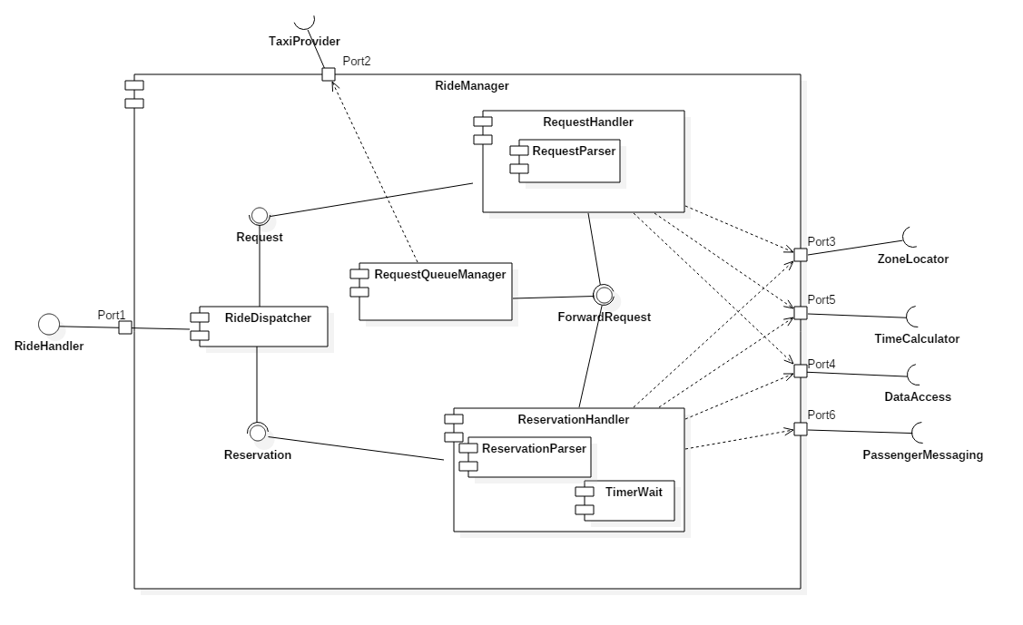

Slide 12
Taxi Manager
StatusHandler
boolean setAvailabilityStatus(TaxiDriver taxiDriver, AvailabilityStatus status)
It assigns a new availability status to a taxi driver.
void setLocation(TaxiDriver taxiDriver, Location location)
It updates the location of a taxi driver.
TaxiProvider
Response provideTaxi(Location location)
Given a valid location, if there is at least one available taxi driver, it returns it.

Slide 13
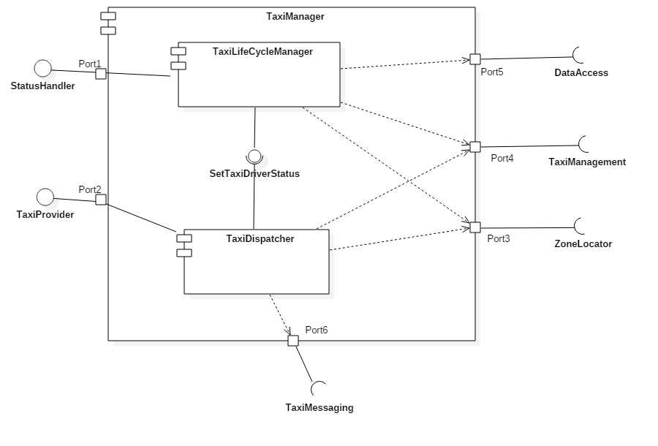

Slide 14
Geographic Engine
ZoneLocator
Zone getTaxiZone(Location location)
It computes the corresponding zone of a given location.
List<Zone> getTaxiZones()
It returns all the zones.
boolean isValidLocation(Location location)
Given a location, it checks whether it is valid or not.
TimeCalculator
Time getTimeEstimation(Location source, Location, destination)
Given valid source and valid location, it returns an approximative traveling time.

Slide 15
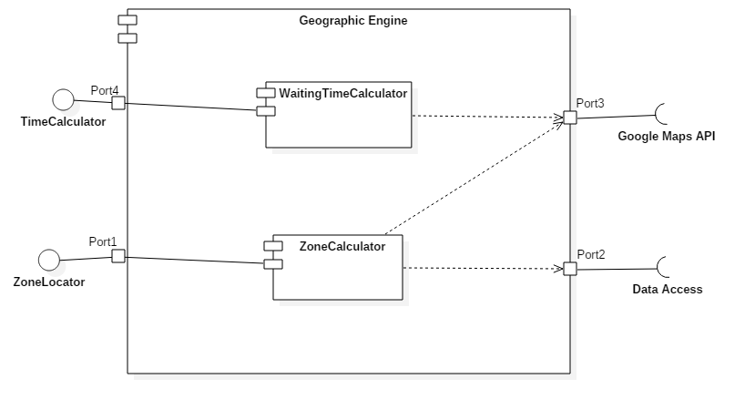

Slide 16
Queue Manager
TaxiManagement
void addTaxi(TaxiDriver taxi, Zone zone)
Given a taxi driver and a zone, it adds the taxi driver to the queue corresponding to the zone.
TaxiDriver getTaxi(Zone zone)
It returns the rst available taxi from the queue corresponding of the given zone.
void removeTaxi(TaxiDriver taxi)
Given a taxi driver, it removes it from the queue he is in.
void changeZone(TaxiDriver taxi, Zone zone)
Given a taxi driver and a zone, it remove the taxi driver from the queue he is in, and add it in the queue corresponding to the zone.

Slide 17
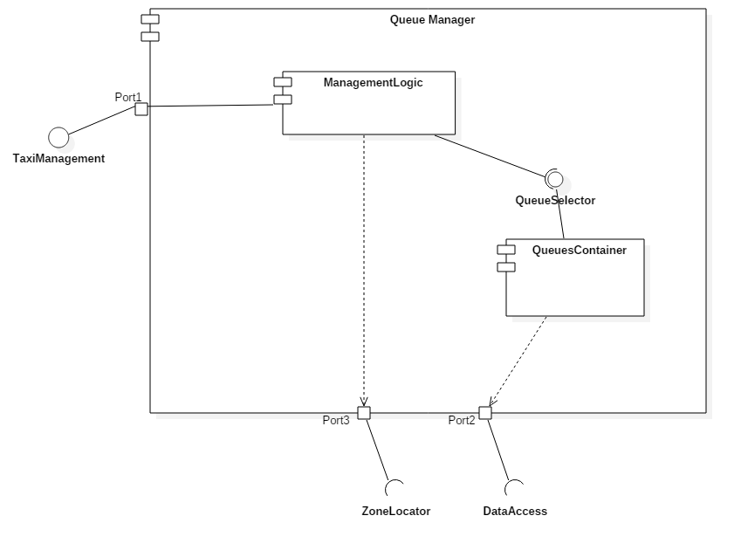

Slide 18
Runtime
NB: we consider as requests the calls for an immediate service and reservations the booking of a taxi
Passenger makes a request
Passenger (application):
Submits the request through the relative form
Ride Handler
Checks if the provided location is valid and calls the taxi manager for a taxi
Geographic engine
Performs the mathematical operations for checking the correctness of the location
Taxi Manager
It provides the taxi for the specified location

Slide 19
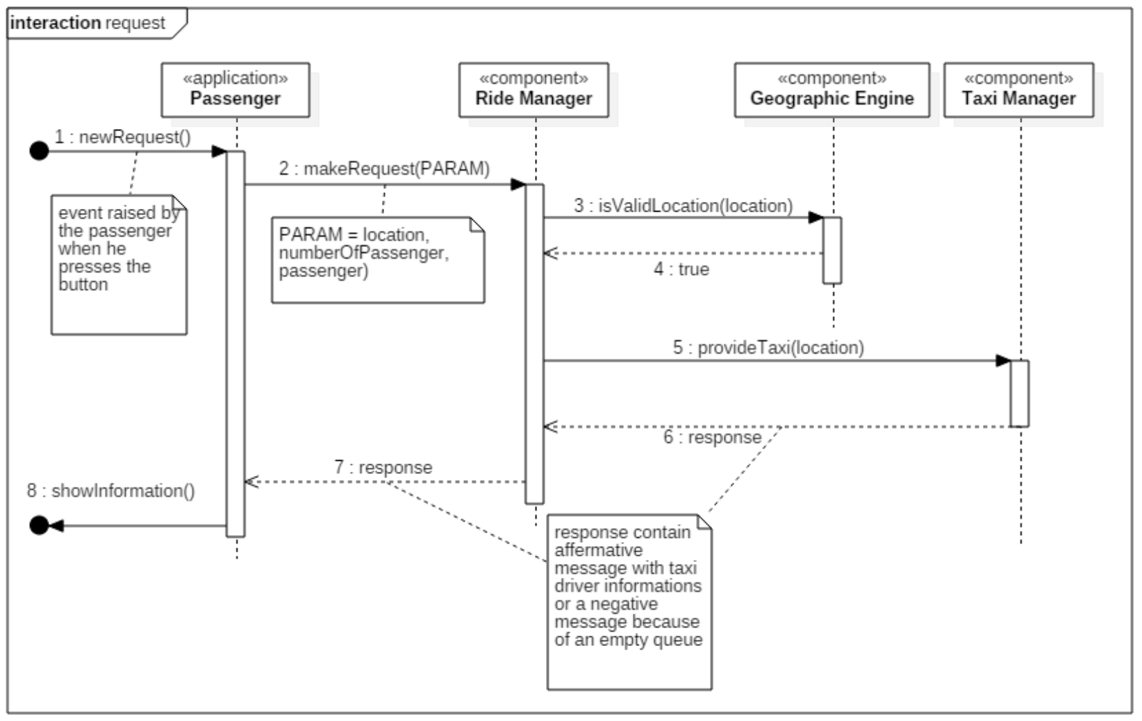

Slide 20
Runtime
Passenger makes a reservation
Passenger (application):
Submits the reservation through a form
Ride Handler:
Checks the correctness of the location and communicate to the passenger’s application the outcome of the process. It then waits until 10 minutes before the specified meeting time. When it is time calls the taxi manager until there is at least a taxi available for that reservation.
Geographic engine:
Checks the correctness of the provided location
Taxi Manager:
if available, provides a taxi for the specified location

Slide 21
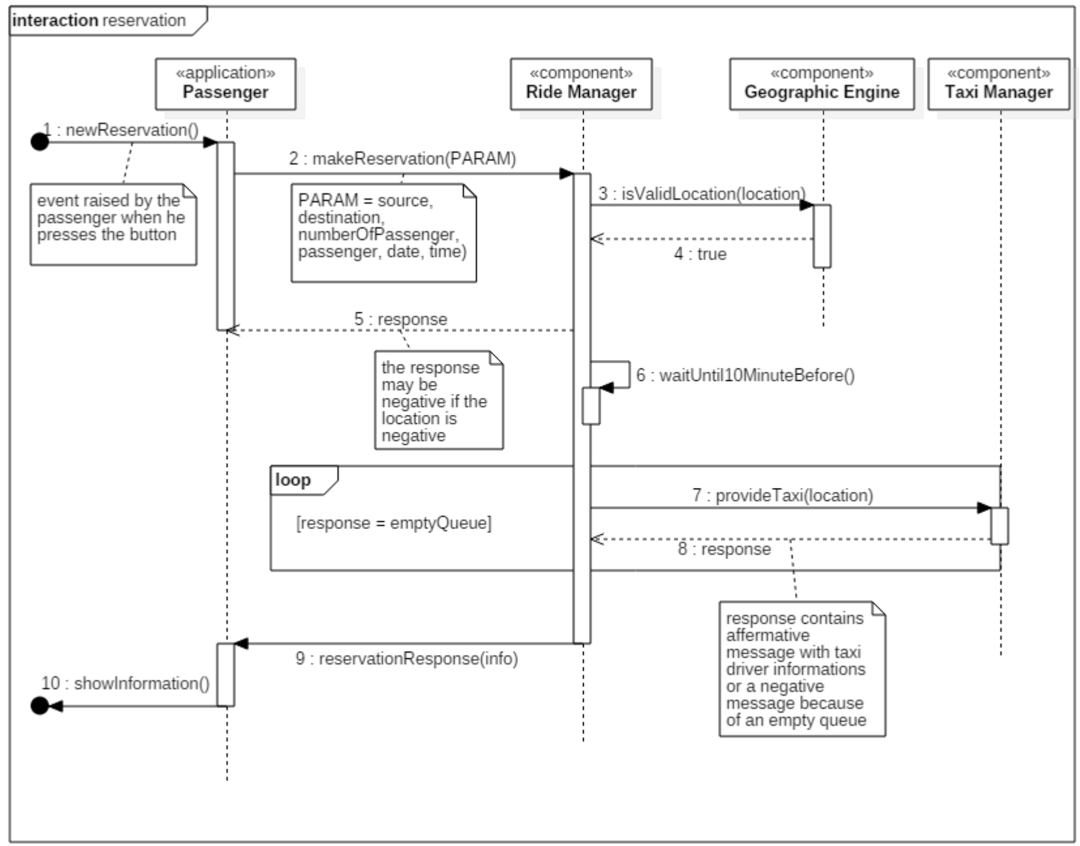

Slide 22
Runtime
Provision of a taxi
Taxi Manager:
Gets the zone relative to the location. Until he finds a taxi driver who accepts the request / reservation, or the queue relative to the zone is empty, it asks to the taxi driver provided by the queue manager.
Taxi driver (application):
The application receives an offer of a request / reservation, it shows up a pop-up and ask the taxi driver to choose what he want to do
Geographic engine
it retrieves the corresponding zone of a provided location
Queue manager
It returns the first taxi driver in the queue of the provided zone. If the queue is empty it returns a negative response

Slide 23
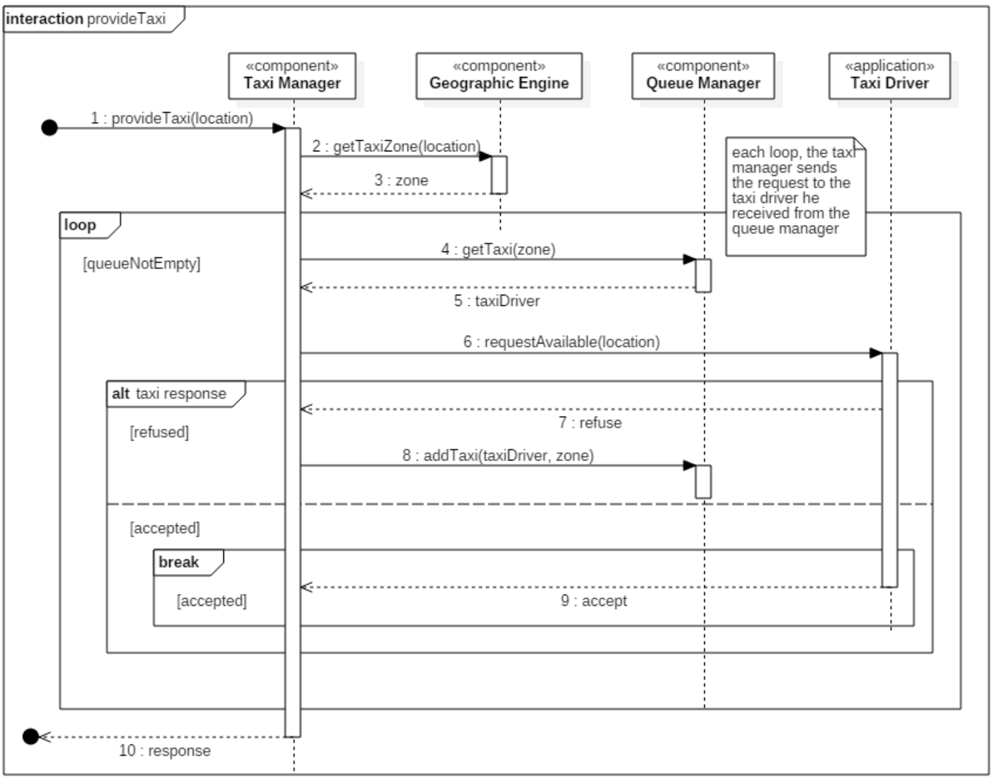

Slide 24
Deployment
Thin clients
Mobile applications interact directly with the Application server - TCP/IP - RMI calls
Browser clients must interact with the web server (Servlet - JSP) - HTTP
One “machine” with both Web server and Application server
Easy and cheap
Data layer separated from logic layer: database(s)
Accessed by logic layer through infrastructural libraries: hibernate
Clouding possibility
Increased reliability
Security
Division of responsibility

Slide 25
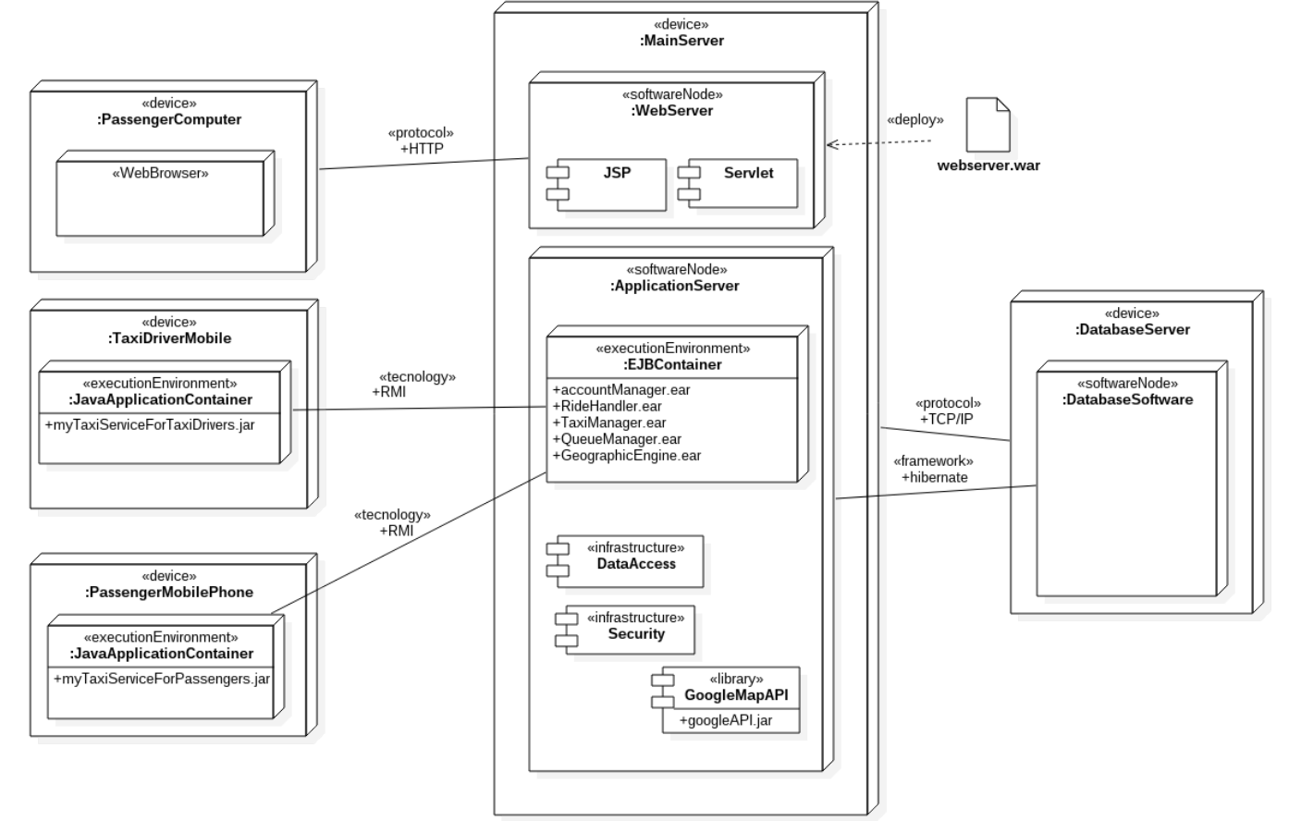

Slide 26
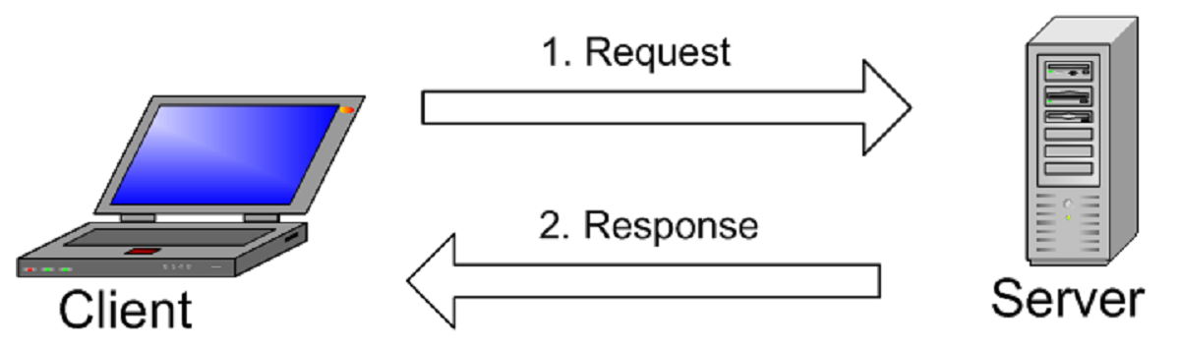
Architectural styles
Client - server (of course):
centrality of the server and sparsity of the clients
absence of business logic client side
Thin clients
Power consumption awareness
Easily modifiable client applications
Easy installation of mobile app
Let’s be more precise...

Slide 27
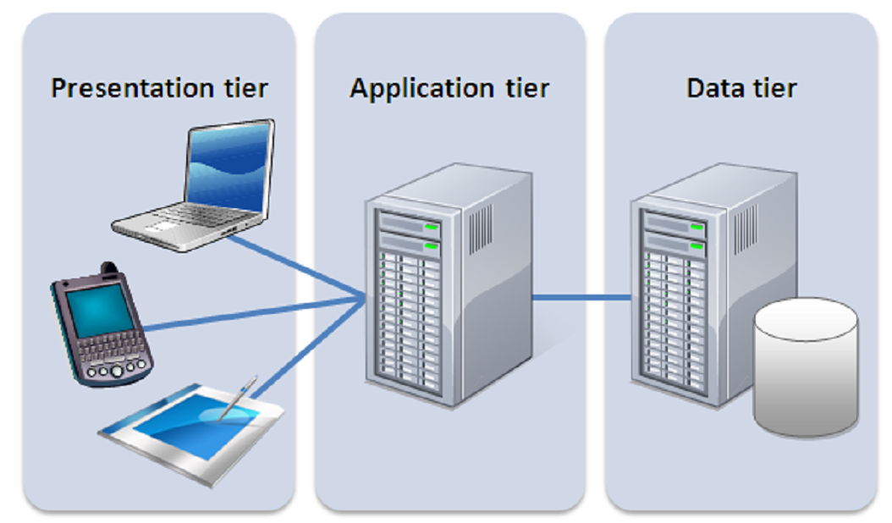
Architectural styles
JEE architecture
Three-tier-architecture
Presentation
graphic rendering, forms, buttons, ecc...
Application
business logic
Data
storage of informations
Easy scalability
Well defined interfaces
Division of responsibility
It is easier the implementation of the required programmatic interface
Possibility of replication
Reliability
Complete independence and modularity:
the presentation must interact first with the application in order to access data
≠ from MVC pattern

Slide 28
Architectural styles
Problem: notification to the clients (passengers and taxi drivers)
Reservation ready
In contrast with the client - server paradigm.
It can be resolved manually through a polling policy client side:
it must be optimize in order to reduce band consumption and server load
there are ready-made framework dedicated to this problem: JMS
variant of the publish-subscribe style
Client
passenger
Server
There is a call for you
Client
taxi driver

Slide 29
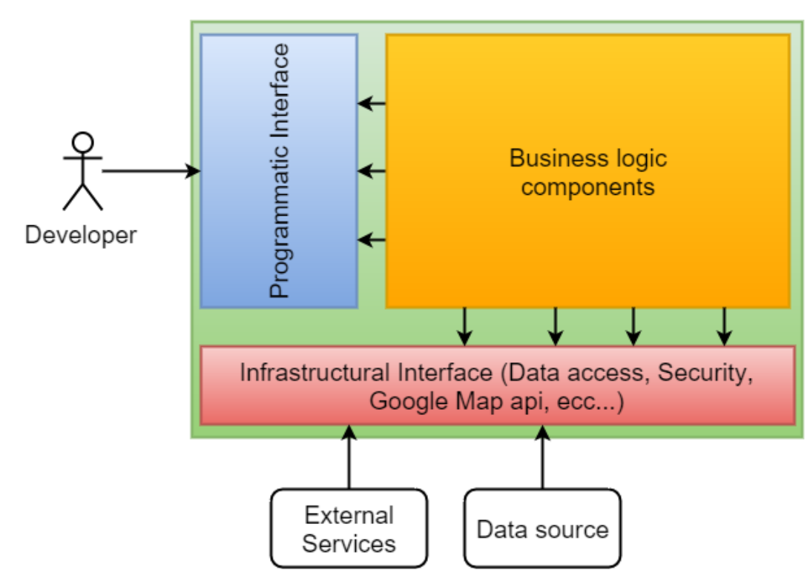
Other design choices
Subdivision into sub-components: D&C
Depend upon interfaces: DIP
In order to implement the programmatic interface
The programmatic interface is exposed to the developers in order to build new features on the top of the provided business logic.
We use the already defined interfaces

Slide 30
Algorithm Design - Reservation Handler
Problem:
Reservations come at any time
Reservations have to be forwarded only 10 minutes before the meeting time
Solution:
Three threads: Receiver, Waiter, Forwarder
Keep the reservations ordered by meeting time
Sleep until 10 minute before the meeting time of the first in the data structure
When a new reservation comes, insert it in the data structure and check if it is the new first element.

Slide 31
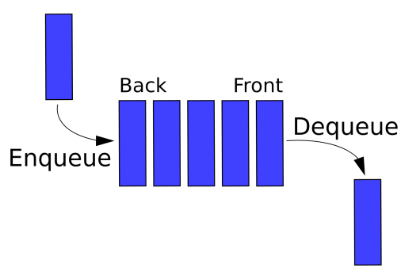
Algorithm Design - Reservation Handler
RECEIVER
reservation_received
put(reservation) //ordered list
if index = first
waitingTime=meetingTime - now
stopCurrentTimer
setTimer(waitingTime)
WAITER
timer_set
wait(waitingTime)
timer_expires
wakeUpForwarder
FORWARDER
woken_up
getFirstReservation
getNextReservationMeetingTime
waitingTime = meetingTime-now
stopCurrentTimer
setTimer(waitingTime)
forwardFirstReservation

